Slide 1
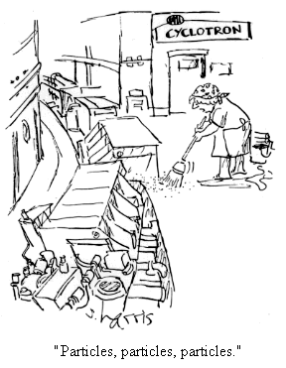
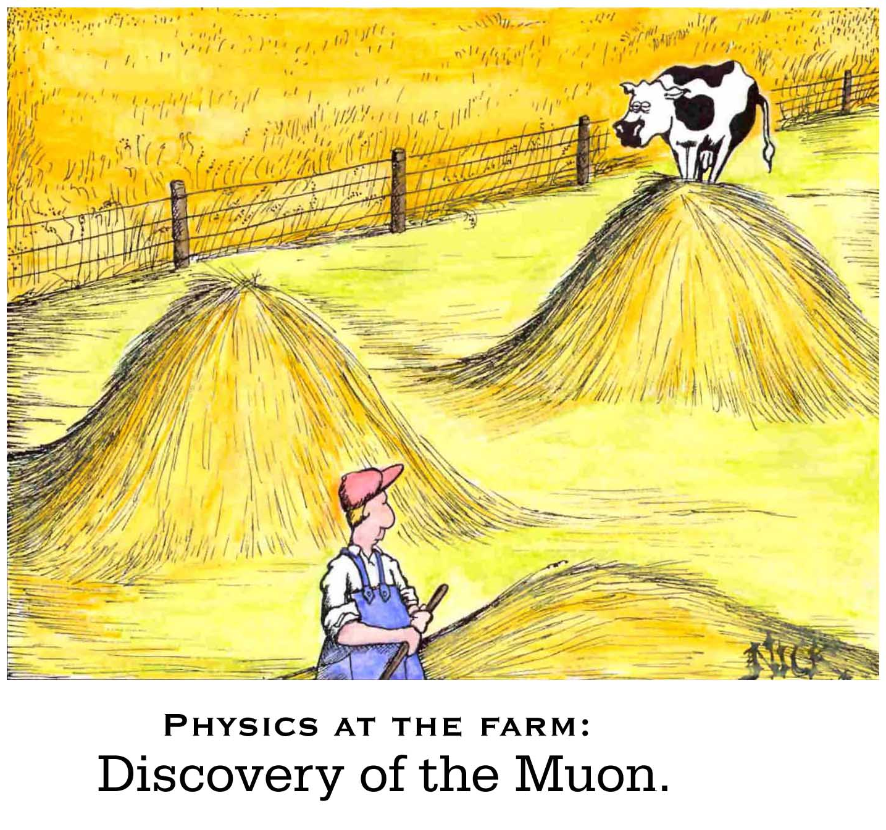

The Fundamental Structure of Matter Who ordered that?

Slide 2

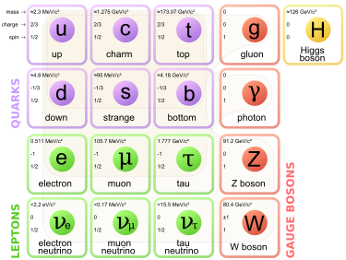
Review – The Quantum Nature of Matter
The Standard Model
From simple, to complicated and then
back to simple again

Slide 3
Review – The Quantum Nature of Matter
Electrons in atoms have well defined “Energy Levels” (E₁, E₂, E₃, E₄, …)
When all the atomic electrons are in their lowest possible energy state, this is called the ground state of the atom.
An electron can be promoted to a higher energy state by doing work on the atom (e.g.., having an electric current pass through a gas of these atoms).
The electron will “spontaneously” fall back to the ground state, and in the process, emit EM radiation (ie., a photon).
The energy of the photon is given by the difference in energy between the initial & final energy levels (ie, E₃-E₂). E = hf

Slide 4
Hydrogen atom energy “levels”
E_{n} = -13.6 / n²
Quantum physics provides the tools to compute the values of E₁, E₂, E₃, etc…The results are:
5
Energy Level (n) | Energy E_{n} (eV)
1 | -13.6
2 | -3.4
3 | -1.51
4 | -0.85
5 | -0.54
4
3
2
1
These results DO DEPEND ON THE TYPE OF ATOM OR MOLECULE
So, the difference in energy between the 3rd and 2nd quantum state is:
E_{diff} = E₃ – E₂ = -1.51 – (-3.4) = 1.89 [eV]
When this 3→ 2 atomic transition occurs, this energy is released in the form of EMR

Slide 5
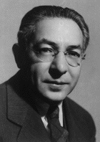
From Simplicity→ Complexity
Around 1930, life seemed pretty good for our understanding of “fundamental particles”.
There were protons, neutrons & electrons.
Together, they made up atoms → molecules → DNA → People !
Nature was simple and elegant
But the discoveries of dozens of more particles in cosmic rays and accelerator experiments lead many to question whether the proton and neutron were really “fundamental”.
Is nature really this cruel ?
Isidor Isaac Rabi’s famous quote when the muon was discovered.
Who ordered that ?
Needless to say, the “zoo of new particles” that were being discovered at accelerators appeared to reveal that nature was not simple, but complicated? Until….
1994 Nobel Prize Winner in Physics

Slide 6
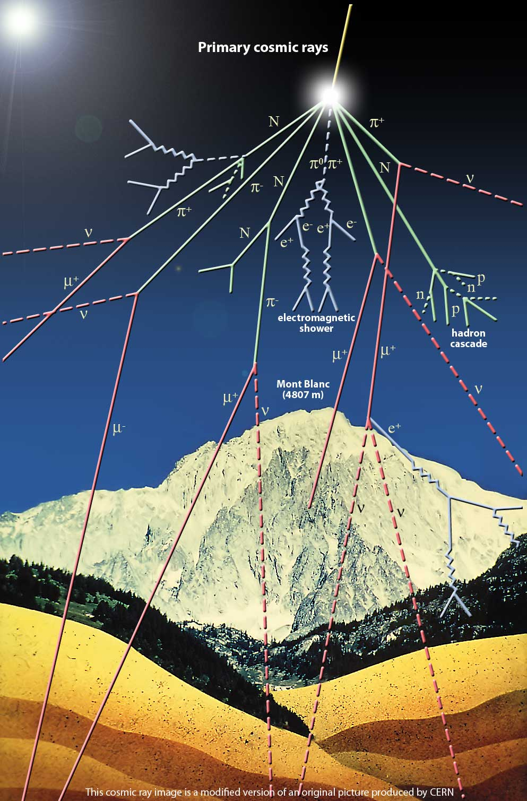
Discoveries in Cosmic Rays
1932 : Discovery of the antiparticle of the electron, the positron. Confirmed the existence and prediction that anti-matter does exist!!!
1937 : Discovery of the muon. It’s very much like a “heavy electron”.
1947 : Discovery of the pion.

Slide 7
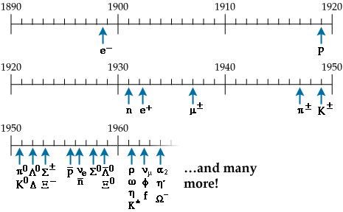
The Plethora of Particles
Because one has no control over cosmic rays (energy, types of particles, location, etc), scientists focused their efforts on accelerating particles in the lab and smashing them together.
Generically people refer to them as “particle accelerators”.
By 1950, these particle accelerators had begun to uncover many new particles.
Most of these particles are unstable and decay very quickly, and hence had not been seen in cosmic rays. Notice the discovery of the proton’s antiparticle, the antiproton, in 1955. Yes, more antimatter !

Slide 8
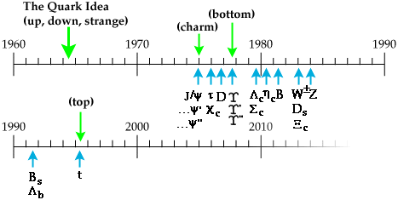
The Plethora of Particles

Slide 9
What is Fundamental?
Physicists have discovered hundreds of new particles
Most, we now know are not fundamental
We have developed a theory, called The Standard Model, which appears to explain what we observe
This model includes 6 quarks, 6 leptons and 13 force-related particles

Slide 10
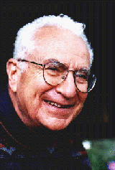
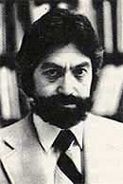
Quarks ?
In 1964, Murray Gell-mann & George Zweig (independently) came up with the idea that one could account for the entire “Zoo of Particles”, if there existed objects called quarks.
Murray Gell-Mann
George Zweig
Murray Gell-Mann had just been reading Finnegan's Wake by James Joyce which contains the phrase "three quarks for Muster Mark".
He decided it would be funny to name his particles after this phrase.
The quarks come in 3 types (“flavors”):
up(u), down(d), and strange(s) and they are fractionally charged with respect to the electron’s charge
Flavor | Q/e
u | +2/3
d | -1/3
s | -1/3

Slide 11
How sure was Gell-Mann of quarks ?
When the quark model was proposed, it was just considered to be a convenient description of all these particles.. A mathematical convenience to account for all these new particles… After all, fractionally charged particles… come on !
An excerpt from Gell-Mann’s 1964 paper:
“A search for stable quarks of charge –1/3 or +2/3 and/or stable di-quarks
of charge –2/3 or +1/3 or +4/3 at the highest energy accelerators would help
to reassure us of the non-existence of real quarks”.
Well….

Slide 12
Scattering Experiments
Rutherford, deBroglie, and others taught us that we can learn about the structure of matter by colliding high energy particles into matter, and seeing what happens.
Recall, Rutherford determined that the atom must contain a dense core of positive charge to account for the large angular deflections of incoming alpha particles.
In order to probe matter of size, say A, the wavelength which you use to probe it must be at least this size, or smaller… Why???
YES, this works !
NO, this doesn’t really work !
λ
A
A
λ

Slide 13
Probing deeper into matter
If we really want to understand if there is anything “inside” a proton or neutron (aka nucleon), we have to examine it with particles whose wavelengths are smaller than the size of a proton. ➔ Since λ = h/mv, we must produce higher momentum particles. That is, the higher the momentum of the particle, the smaller it’s deBroglie wavelength
➔ thus we can “see”, or “probe” smaller things
Since the proton’s size is very small, about 1x10⁻¹⁵ [m], We need very energetic beams of particles (high momentum) to probe it’s structure.
By the 1960’s, physicists had learned how to produce high energy, well-focused, beams of particles, such as electrons or protons (particle accelerators !)

Slide 14
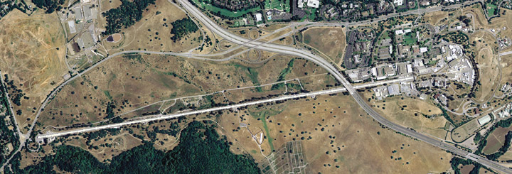
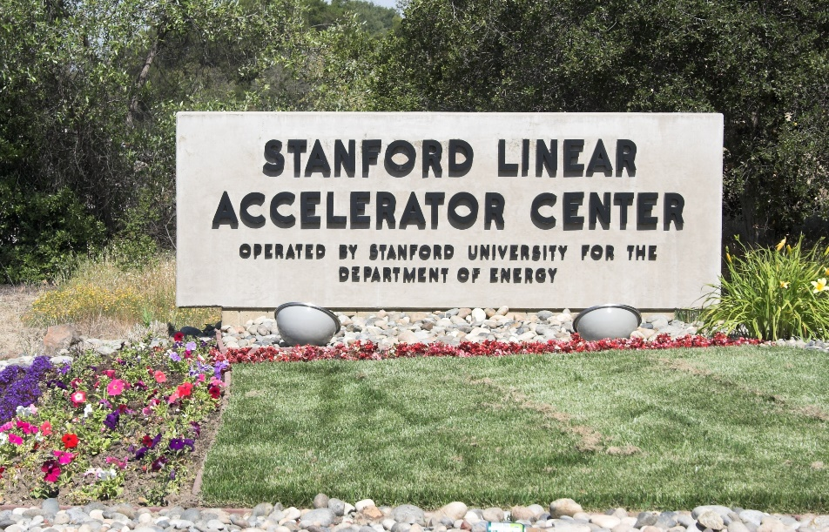
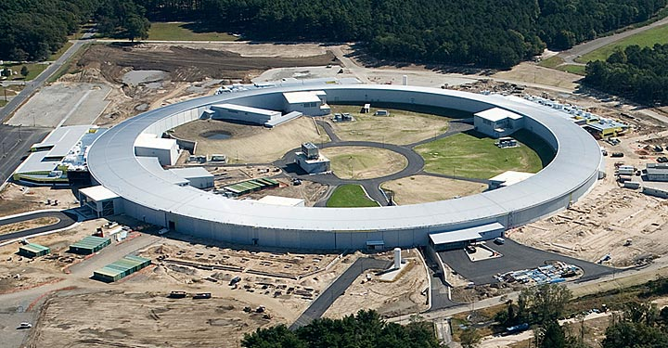
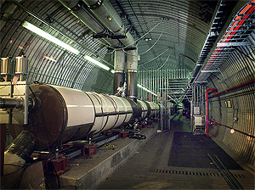

Probing deeper into matter

Slide 15
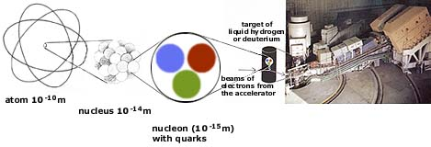
Are protons/neutrons fundamental ?
In 1969, a Stanford-MIT Collaboration was performing scattering experiments
What they found was remarkable; the results were as surprising as what Rutherford had found more than a half-century earlier!
The number of high angle scatters was far in excess of what one would expect based on assuming a uniformly distributed charge distribution inside the proton.
It’s as if the proton itself contained smaller constituents

Slide 16
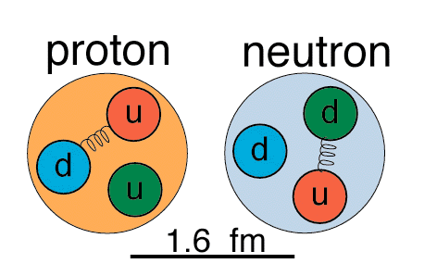
Quarks
Since 1969, many other experiments have been conducted to determine the underlying structure of protons/neutrons. All the experiments come to the same conclusion. ➔ Protons and neutrons are composed of smaller constituents. These quarks are the same ones predicted by Gell-Mann & Zweig in 1964.
Protons 2 “up” quarks 1 “down” quark
Neutrons 1 “up” quark 2 “down” quarks
1x 10⁻¹⁸ m
(at most)
(1.6 x 10⁻¹⁵ m)
Are there any other quarks other than UP and DOWN ?

Slide 17
Three Families of Quarks
 | Generations
 | I | II | III
Charge = -1/3 | d (down) | s (strange) | b (bottom)
Charge = +2/3 | u (up) | c (charm) | t (top)
Increasing mass
Fractionally charged particles!
Also, each quark has a corresponding antiquark. The antiquarks have opposite charge to the quarks

Slide 18
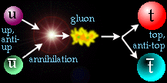
Matter and Antimatter
For every particle ever found, there is a corresponding antimatter particle or antiparticle
They look just like matter but have the opposite charge
Particles are created or destroyed in pairs

Slide 19
Particles can decay
Particles may decay, i.e. transform from one to another
Most are unstable
Proton and electron are stable
Neutron can decay to electron and a proton
Energy appears to be missing. It is carried off by a neutrino

Slide 20
The 6 Quarks, when & where…
Quark | Date | Where | Mass [GeV/c²] | Comment
up, down | - | - | ~0.005, ~0.010 | Constituents of hadrons, most prominently, proton and neutrons.
strange | 1947 | - | ~0.2 | discovered in cosmic rays
charm | 1974 | SLAC/ BNL | ~1.5 | Discovered simultaneously in both pp and e⁺e⁻ collisions.
bottom | 1977 | Fermi- lab | ~4.5 | Discovered in collisions of protons on nuclei
top | 1995 | Fermi-lab | ~175 | Discovered in pp collisions
Notice the units of mass !!!
SLAC = Stanford Linear Accelerator BNL = Brookhaven National Lab

Slide 21


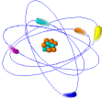
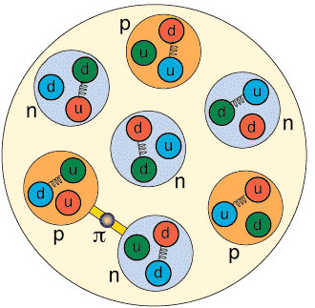
A Sense of Scale
<1x10⁻¹⁸ [m]
~5x10⁻⁶ [m]
~2x10⁻⁹ [m]
~2x10⁻⁸ [m]
~5x10⁻¹⁵ [m]
~1.5x10⁻¹⁵ [m]
Quarks and leptons are the most elementary particles we know about at this time. They are no larger than 10⁻¹⁸ [m]
q
e

Slide 22
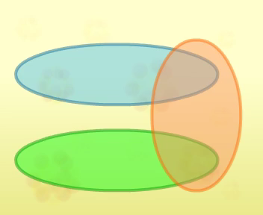
Matter & Forces

Slide 23
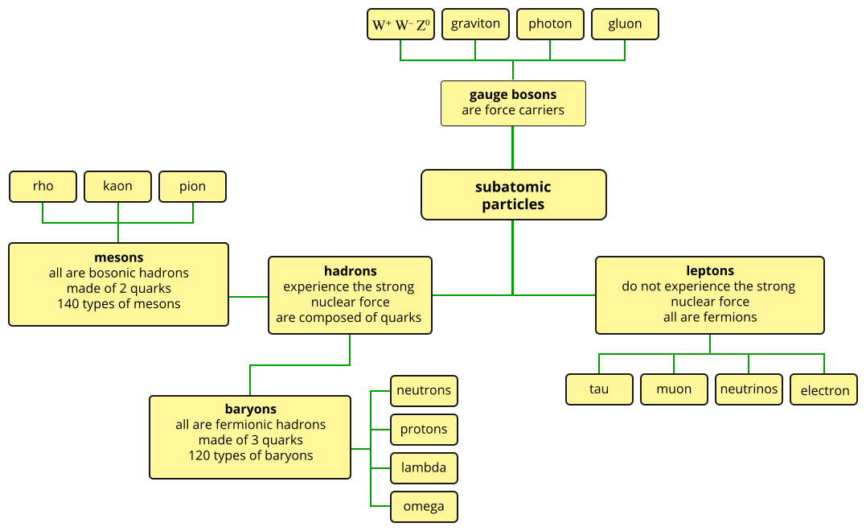
Matter & Forces

Slide 24
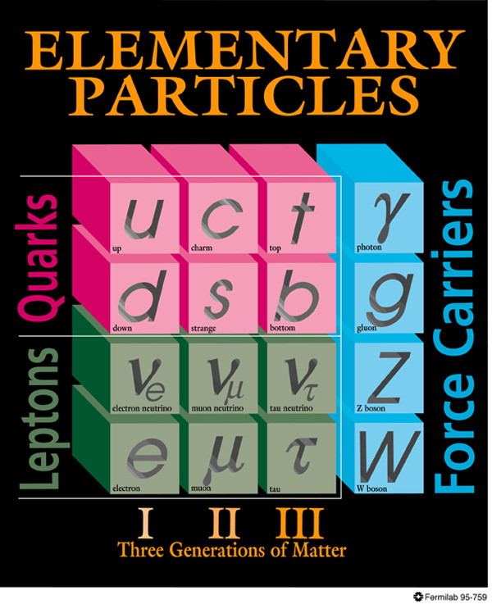
The Standard Model
Quarks and leptons are the most fundamental particles of nature that we know about.
Up & down quarks and electrons are the constituents of ordinary matter.
The other quarks and leptons tend to be unstable and can be produced in cosmic ray showers or in high energy particle accelerators.
Each particle has a corresponding antiparticle.

Slide 25
What about Leptons?
There are six leptons, three charged and three neutral.
They appear to be point-like particles with no internal structure.
Electrons are the most common and are the only ones found in ordinary matter.
Muons (μ) and taus (τ) are heavier and charged like the electron
Neutrinos have no charge and very little mass.

Slide 26
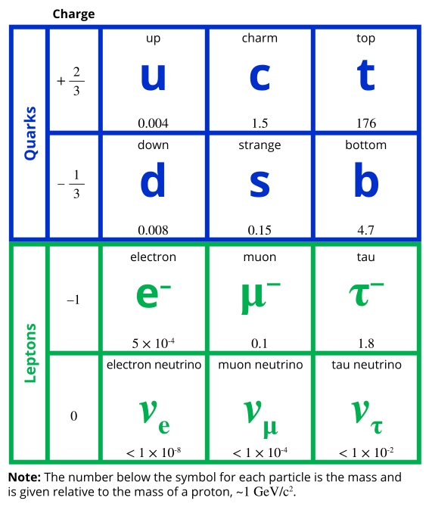
The Standard Model
You should know the symbols and charges for the 12 main fermions

Slide 27
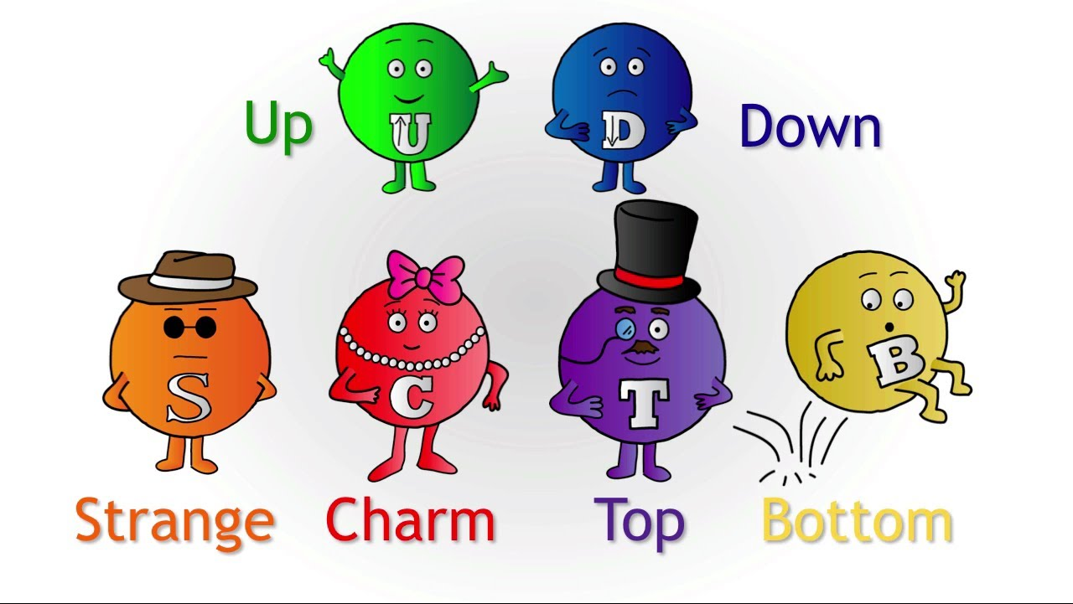
The cast of quarks & leptons
Family | Quarks |  | Antiquarks
 | Q = +2/3 | Q = -1/3 | Q = -2/3 | Q = +1/3
1 | U | D(own)
2 | C | s
3 | t | b
Family | Leptons |  | Antileptons
 | Q = -1 | Q = 0 | Q = +1 | Q = 0
1 | e⁻ | ν_{e} | e⁺ | ν_{e}
2 | μ⁻ | ν_{μ} | μ⁺ | ν_{μ}
3 | τ⁻ | ν_{τ} | τ⁺ | ν_{τ}

Slide 28
What are these?

Slide 29
Quarks versus Leptons
What are the primary differences between quarks and leptons?
Both are fundamental particles, in that as far as we know they do not have internal structure.
Quarks however are never found alone, whereas Leptons are.
Quarks have fractional charge whereas Leptons are integer charge.
Ultimately, what differentiates the quarks & leptons from one another are the forces which each may exhibit.
Quarks interact with each other via the Strong Nuclear Force. Leptons do not and usually interact by the electromagnetic force instead.
We therefore now embark on the concept of forces.

Slide 30

How do Particles Interact?
Objects can interact without touching
How do magnets “feel” each other to attract or repel?
How does the sun attract the earth?
A force is something communicated between objects

Slide 31
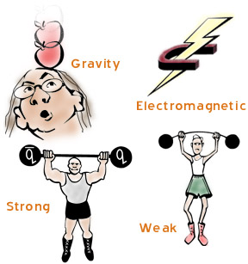
The Four Fundamental Forces
Gravity
Weak Force
Electromagnetic force
Strong Force
Weaker
Stronger
All other forces you know about can be attributed to one of these!

Slide 32
Force Carriers
Previously we have thought of forces being exerted on particles by fields.
For example, we have said that there would be a region around a charged particle where another charged particle experiences a force.
This may seem quite puzzling as the force is applied without any direct interaction by the two particles. In the Standard Model this is resolved.
The mechanism explaining how forces are exerted involves the exchange of other particles.

Slide 33
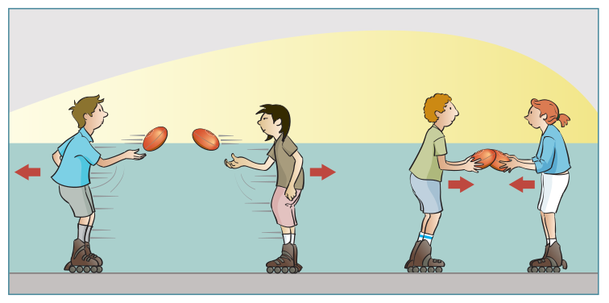
Force Carriers
Let's use an analogy to see how a force can be exerted on two particles through the exchange of another particle.
On the figure above, two inline skaters stand stationary and then begin to pass footballs back and forth to each other. As they do this they will begin to move away from each other. This is due to the conservation of momentum each time they throw and catch a ball.
This situation would be analogous to two particles experiencing a repulsive force.

Slide 34
Force Carriers
A force of attraction can also be illustrated using an analogy above
If the two skaters now exchange the footballs by grabbing them out of the other's hands, they exert a force of attraction on each other.
This causes them to move together and is analogous to two particles experiencing an attractive force.

Slide 35
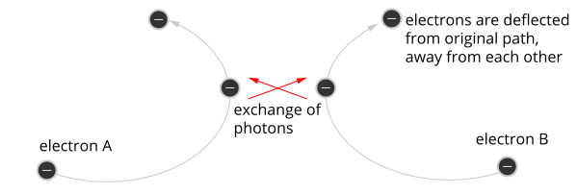
Force Carriers
The diagram above represents an electron approaching another electron.
Each electron emits a photon that is absorbed by the other.
This causes each electron to experience a force of repulsion, and the photon is responsible for the electromagnetic force acting on the two electrons.

Slide 36
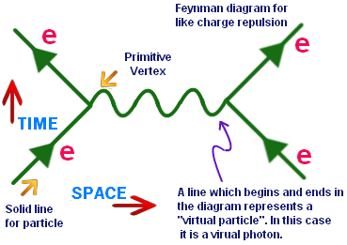
Force Carriers – Feynman Diagrams
The Feynman diagram above represents the same electron approaching another electron. The exchange of the photon causes the repulsion due to conservation of momentum.

Slide 37
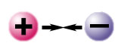
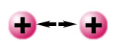
Electromagnetism
The electromagnetic force causes opposite charges to attract and like charges to repel
The carrier is called the photon (γ)
The photon is massless and travels at “the speed of light”

Slide 38
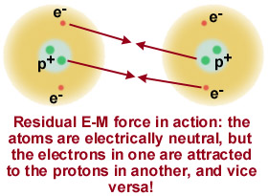
Residual E-M
Normally atoms are neutral having the same number of protons and electrons
The charged parts of one atom can attract the charged parts of another atom
This can bind atoms into molecules.

Slide 39
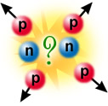
Why Doesn’t a Nucleus Explode?
A heavy nucleus contains many protons, all with positive charge
These repel each other
Why does it not blow apart?

Slide 40

Strong Force
In addition to their electric charge, quarks also carry a new kind of charge called colour charge.
The force between colour charged particles (quarks) is the “strong force”

Slide 41

The Gluon
The strong force holds quarks together to form hadrons
Its carrier particles are called gluons; there are 8 of these
The strong force only acts on very short distances

Slide 42
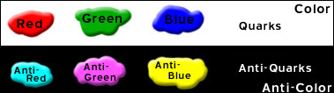
Colour and Anti-colour
There are three colour charges and three anti-colour charges.
But note, these colours have nothing to do with colour and visible light, they are only a way describing the physics

Slide 43
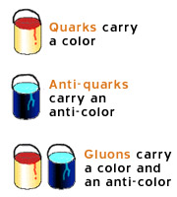
Coloured Quarks and Gluons
Each quark has one of the three colour charges and each antiquark has one of the three anti colour charges
Baryons and mesons are colour-neutral just as red-green-blue makes white light

Slide 44
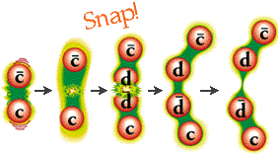
Colour Field
Quarks in a hadron exchange gluons
If one of the quarks is pulled away from its neighbors, the colour field stretches between that quark and its neighbors
New quark-antiquark pairs are created in the field

Slide 45

Quarks Emit Gluons
When a quark emits or absorbs a gluon, the quarks colour charge must change to conserve colour charge
A red quark emits a red/antiblue gluon and changes into a blue quark

Slide 46
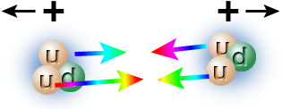
Residual Strong Force
The strong force between the quarks in one proton and the quarks in another proton is strong enough to overwhelm the repulsive electromagnetic force

Slide 47
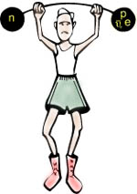
Weak Force
Weak interactions are responsible for the decay of massive quarks and leptons into lighter quarks and leptons
Example: neutron to decay into proton + electron + neutrino
This is why all matter consists of the lightest quarks and leptons (plus neutrinos)

Slide 48

Electroweak Force
In the Standard Model, the weak and the electromagnetic forces have been combined into a unified electroweak theory
At very short distances (~10⁻¹⁸ meters), the weak and electromagnetic interactions have comparable strengths
Force particles are photon, W and Z

Slide 49

What about Gravity?
Gravity is very weak
Relevant at macroscopic distances
The gravity force carrier, the graviton, is predicted but has never been seen

Slide 50
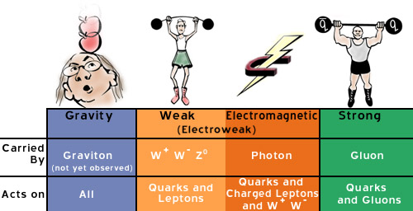
Interaction Summary

Slide 51
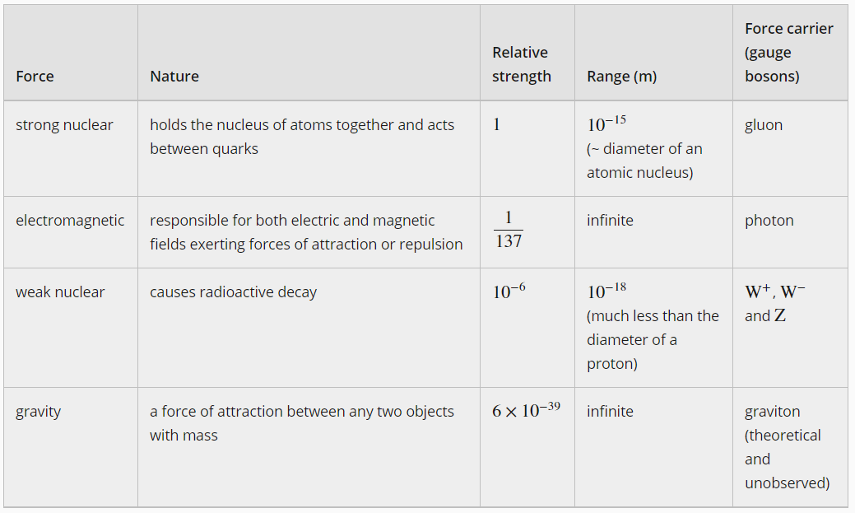
The Four Fundamental Forces

Slide 52

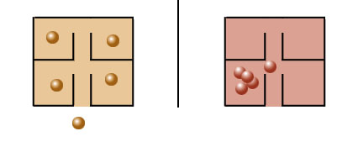
The Pauli Exclusion Principle
We can use quantum particle properties to categorize the particles we find
Some particles, called Fermions, obey the Exclusion Principle while others, called Bosons, do not

Slide 53
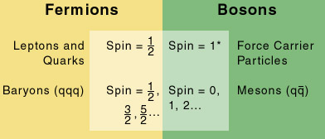
Fermions and Bosons

Slide 54
What Holds the World Together?
We have learned that the world is made up of six quarks and six leptons
Everything we see is a conglomeration of quarks and leptons (and their antiparticles)
There are four fundamental forces and there are force carrier particles associated with each force

Slide 55
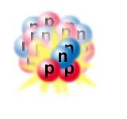
The Unstable Nucleus
We have seen that the strong force holds the nucleus together despite the electromagnetic repulsion of the protons
However, not all nuclei live forever
Some decay

Slide 56
How does a particle decay?
The Standard Model explains why some particles decay into other particles
In nuclear decay, a nucleus can split into smaller nuclei
When a fundamental particle decays, it has no constituents (by definition) so it must change into totally new particles

Slide 57

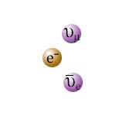
Muon Decay
Muon decay is an example of particle decay
Here the end products are not pieces of the starting particle but rather are totally new particles

Slide 58
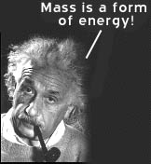
Missing Mass
In most decays, the particles or nuclei that remain have a total mass that is less than the mass of the original particle or nucleus
The missing mass gives kinetic energy to the decay products

Slide 59
Particle Decay Mediators
When a fundamental particle decays, it turns itself into a less massive particle and a force-carrier particle (the W boson)
The force-carrier then emerges as other particles
A particle can decay if it is heavier than the total mass of its decay products and if there is a force to mediate the decay

Slide 60
Virtual Particles
Particles decay via force-carrier particles
In some cases, a particle may decay via a force-carrier that is more massive than the initial particle
The force-carrier particle is immediately transformed into lower-mass particles
The short-lived massive particle appears to violate the law of energy conservation

Slide 61
Different Interactions
Strong, electromagnetic, and weak interactions all cause particle decays. However, only weak interactions can cause the decay of fundamental particles into other types of particles.
Physicists call particle types "flavors." The weak interaction can change a charm quark into a strange quark while emitting a virtual W boson (charm and strange are flavors).
Only the weak interaction (via the W boson) can change flavor and allow the decay of a truly fundamental particle.

Slide 62
Other Interactions
Electromagnetic Decays:
The π⁰ (neutral pion) is a meson. The quark and antiquark can annihilate; from the annihilation come two photons. This is an example of an electromagnetic decay.
Strong Decays:
The η_{c} particle is a meson made up of a c and an anti-c. It can undergo a strong decay into two gluons (which emerge as hadrons).

Slide 63
Annihilations
These are not decays but they also take place through virtual particles
Annihilations of light quarks at very high energy can produce very massive quarks in the laboratory

Slide 64
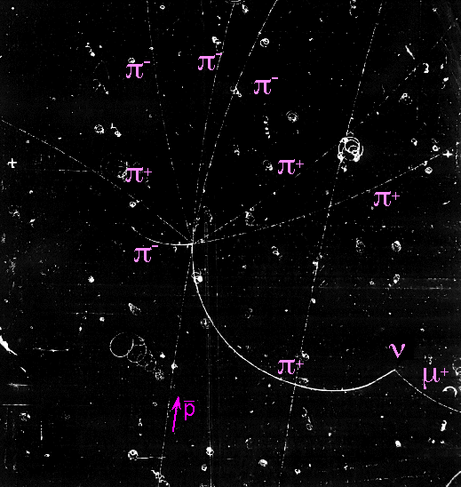
Antiproton Annihilation
This bubble chamber shows an antiproton colliding with a proton, annihilating and producing eight pions
One pion decays into a muon and a neutrino (which leaves no track)

Slide 65
Mysteries and Failures
The Standard Model is a theory of the universe
It provides a good description of phenomena observed by experiments
It is still incomplete in many ways: why 3 generations? What is dark matter?

Slide 66
Is the Standard Model Wrong?
We need to go beyond the Standard Model in the same way that Einstein’s Theory of Relativity extended Newton’s laws of mechanics
We will need to extend the Standard Model with something new to explain mass, gravity, etc.

Slide 67
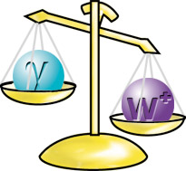
What About Masses?
The Standard Model cannot explain why a particle has a certain mass
Physicists have theorized the existence of a new field, called the Higgs field, which interacts with other particles to give them mass
Recently we believe the Higgs boson may have been detected at the Large Hadron Collider. More experiments are required to confirm.

Slide 68
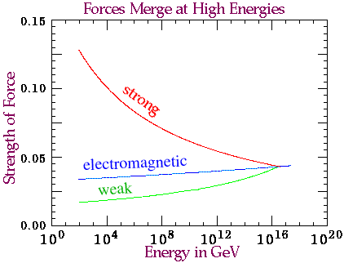
Grand Unified Theory – Future Directions
We believe that GUT will unify the strong, weak and electromagnetic forces
All three forces would be different aspects of the same, unified interaction
The three forces would merge into one at high enough energy

Slide 69
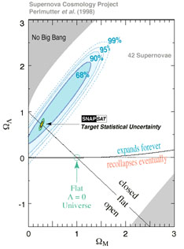
The Accelerating Universe
Recent experiments using Type Ia Supernovae have shown that the universe is still expanding and the rate of expansion is increasing
This acceleration must be driven by a new mechanism which has been named dark energy

